Slide 1


Slide 2
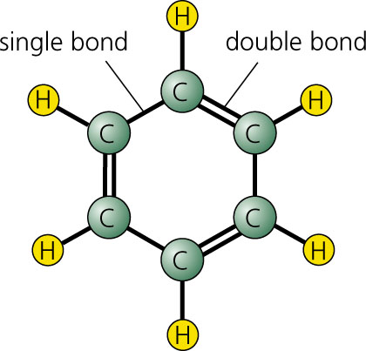

Slide 3
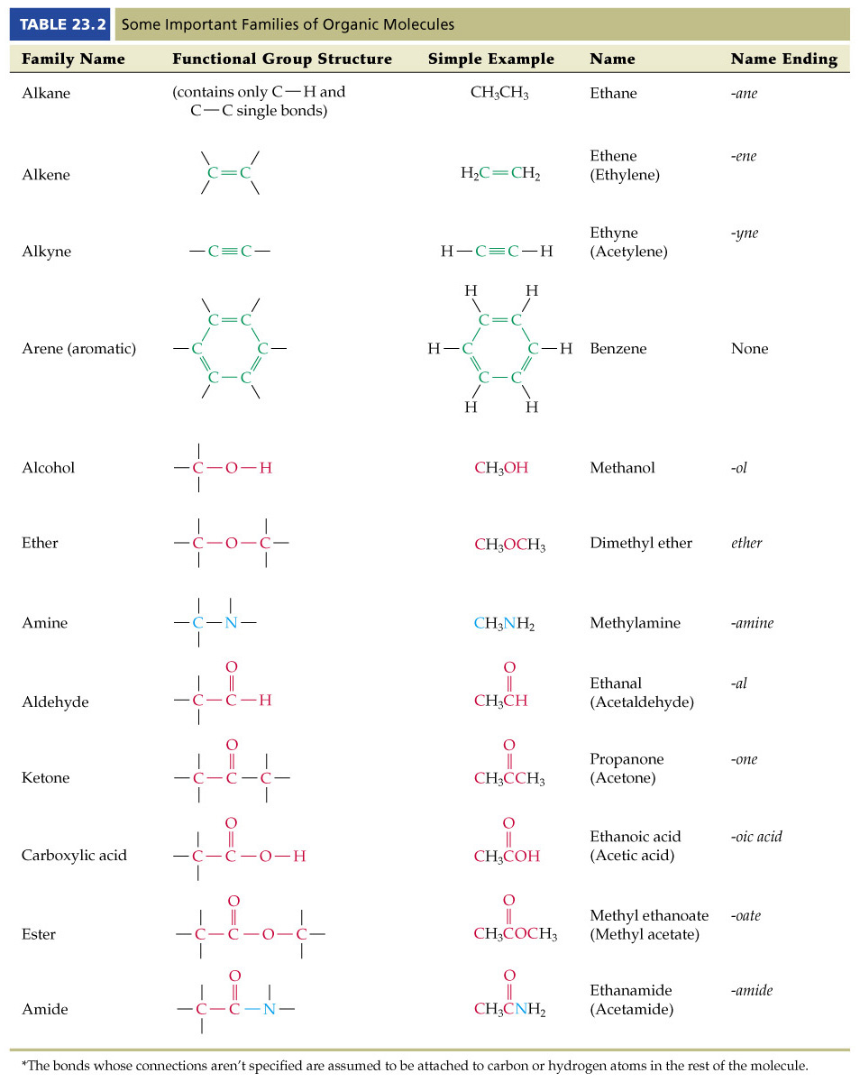
Chapter 23.4 is not part of this course
Chapter 23.10 is not part of this course

Slide 4
Chapter 23.10 not part of this course

Slide 5
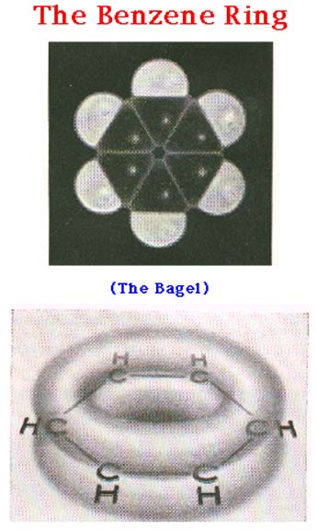

Slide 6
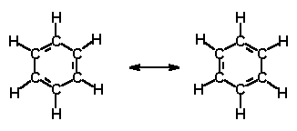

Slide 7
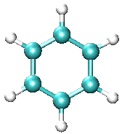

Slide 8
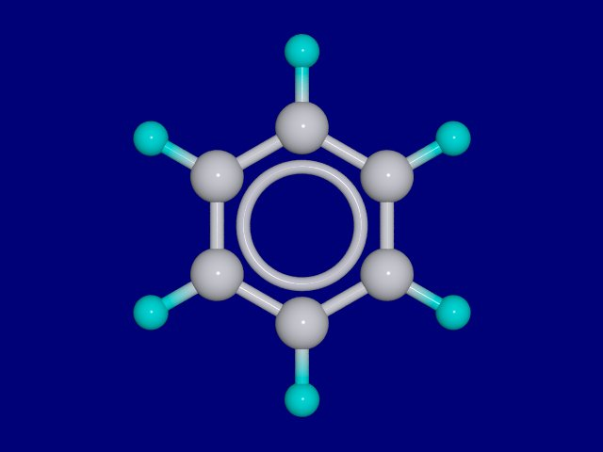

Slide 9
http://people.ouc.bc.ca/woodcock/molecule/molecule.html
Organic Molecules Link

Slide 10
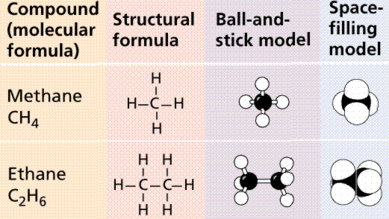

Slide 11
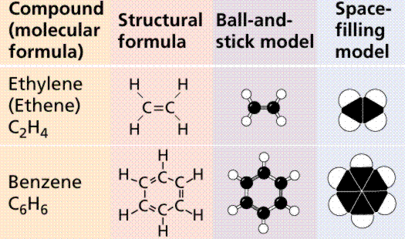

Slide 12
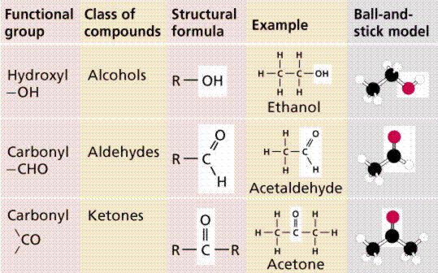

Slide 13
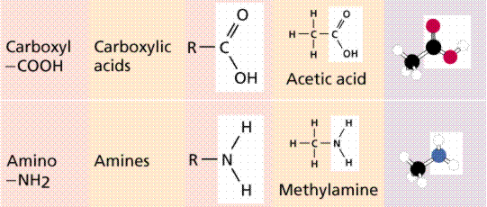

Slide 14
